Slide 1
SAM(Limit of Operation,Visulization)
Case Study Of Intelligent System In Production
Prof. Tim Weber
Group 1
1. Ranveer Patil
2. Shokhrukh Khamidov
3. Nevil Rafaliya
4. Naimish Savaliya
5. Zeel Navadiya

Slide 2
Outlines
SAM Introduction and Principle
Objective
Meaning Of Turbidity
Reasons to use water
Methodology
Bill of material
Expected outcomes
Conclusion

Slide 3
SAM Introduction and Principle
Introduction:
Scanning Acoustic Microscopy (SAM) is a non-destructive imaging technique used to analyze the internal structure and properties of materials at micrometer and nanometer scales.
It utilizes high-frequency ultrasound waves to inspect materials, providing detailed information about their internal features such as defects, microstructure, and material properties.
Principle:
SAM operates on the principle of acoustic microscopy, where ultrasonic waves are generated and transmitted into the material being studied.
A transducer generates high-frequency sound waves (typically in the range of tens to hundreds of megahertz), which are focused onto the sample surface.
These sound waves travel through the material, and their interaction with internal features such as interfaces, inclusions, or defects causes reflection, scattering, or diffraction of the waves.

Slide 4
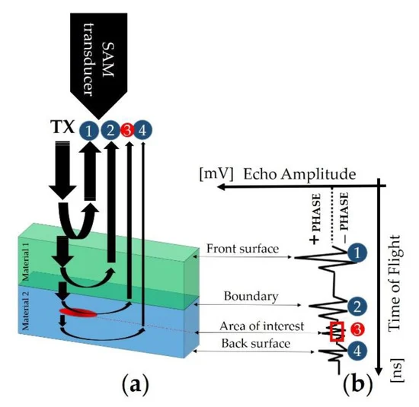
Transducer emits ultrasonic waves into the direction of material, waves hit the surface externally and internally and reflect back to the transducer.
Echoes are created and are being read by sensor.
https://www.mdpi.com/1424-8220/19/22/4868

Slide 5
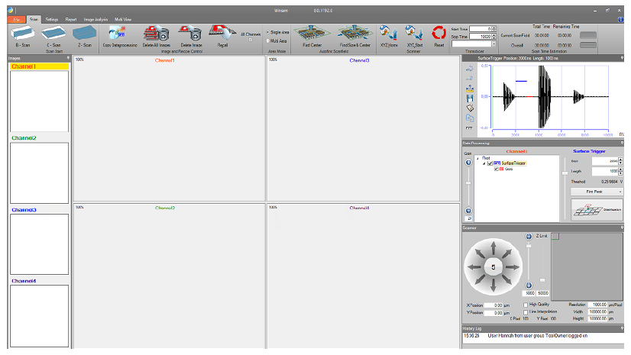
Software: SAM => WinSAM
Generally, it handles advanced image analysis, provides a defect detection functionality,
size and position analysis.
A-scans, B-scans and C-scans.
Serves as a main conjunction tool with SAM equipment.

Slide 6
Objective
The primary objective of our project is to develop an intelligent system capable of accurately measuring turbidity in water.
This system will provide real-time data on water quality, enabling prompt intervention in case of contamination
Additionally, we aim to create a interface for visualizing and understanding turbidity, enhancing accessibility for users.

Slide 7
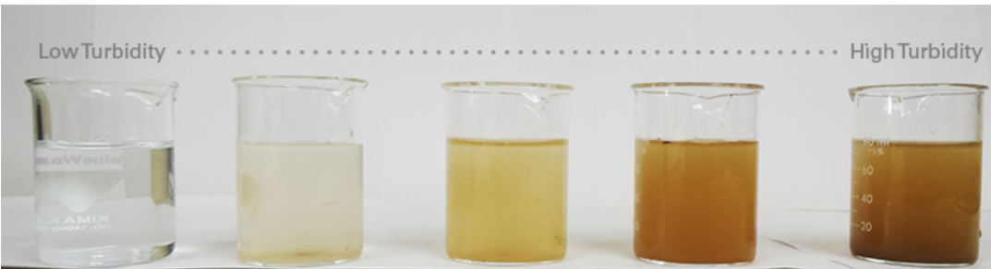
Meaning Of Turbidity
Turbidity is a measure of the cloudiness or haziness of a liquid caused by suspended particles that are not dissolved. These particles can include clay, silt, fine organic matter, algae, microorganisms, and other substances. The presence of these particles scatters light passing through the liquid, making it appear cloudy or opaque.
Turbidity is commonly measured using a turbidimeter, which quantifies the amount of light scattered by the suspended particles in the liquid.

Slide 8
Reasons
Water is commonly used as a coupling medium in scanning acoustic microscopy (SAM) for several reasons:
To Transmit: Water helps to transmit the acoustic waves efficiently between the transducer and the sample being analyzed.
Reduction of Air Gap: Water eliminates the presence of air between the transducer and the sample, which could cause significant reflections and distortions in the acquired images. This ensures more accurate results.
Cooling: Acoustic microscopy often generates heat due to the high-frequency sound waves. Water serves as a coolant, dissipating heat and preventing damage to the equipment and the sample.
Contaminants:
Biological Contaminants: If the water used is not properly sterilized, it can contain bacteria, algae, or other microorganisms, especially if it is stored for long periods.
Chemical Contaminants: Impurities present in water such as minerals, salts, or other chemicals can contaminate the water and affect the acoustic properties, potentially leading to inaccuracies in the results.

Slide 9
Methodology
Sensor Setup: Set up SAM Arduino with turbidity sensors to measure the clarity of water samples.
Display Setup: Setup to display the quality of water.

Slide 10
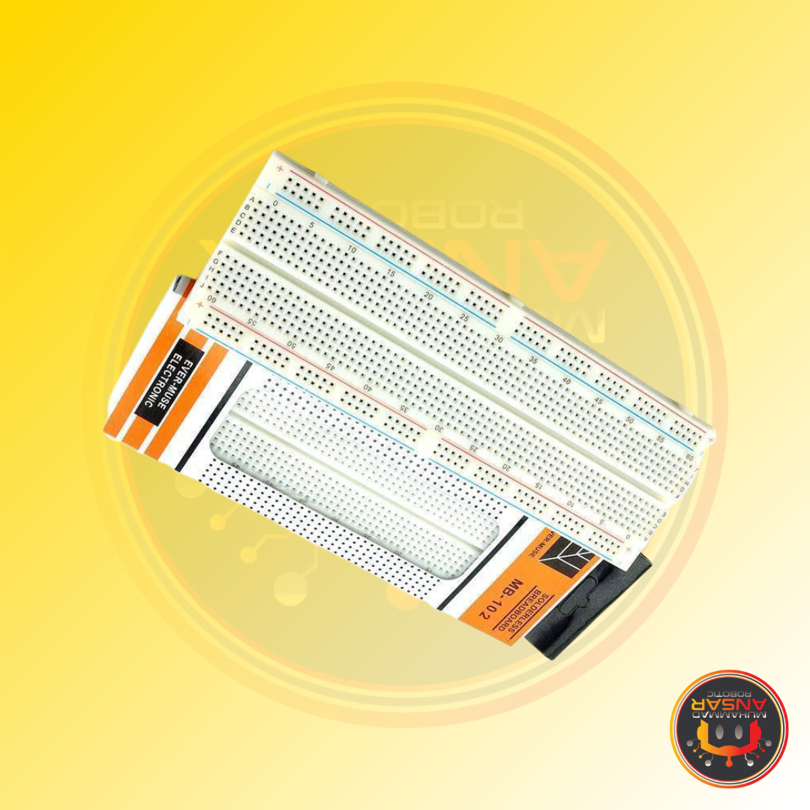
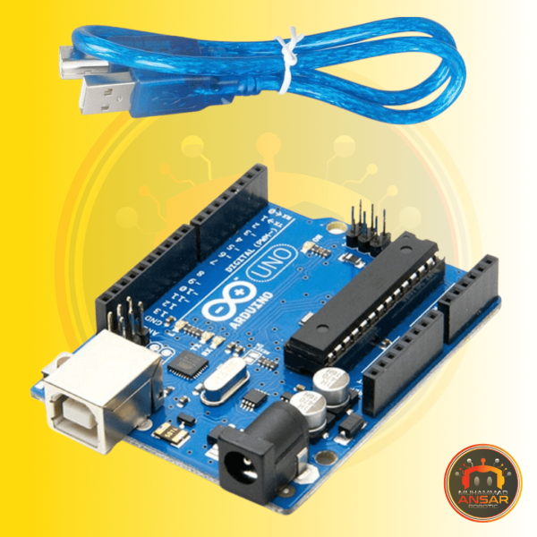
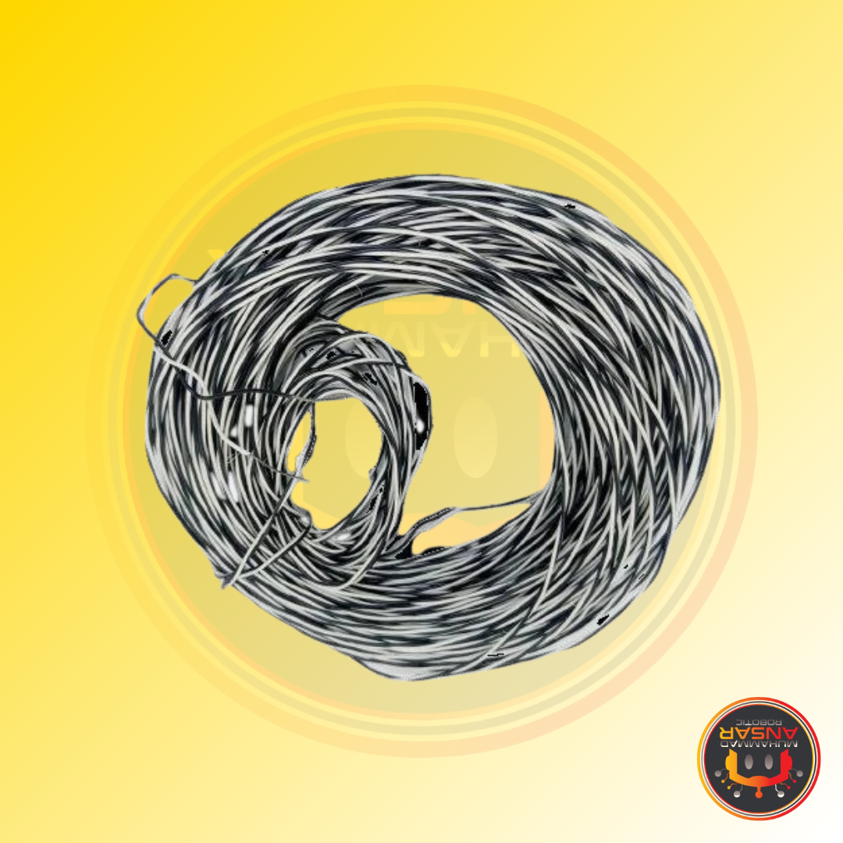
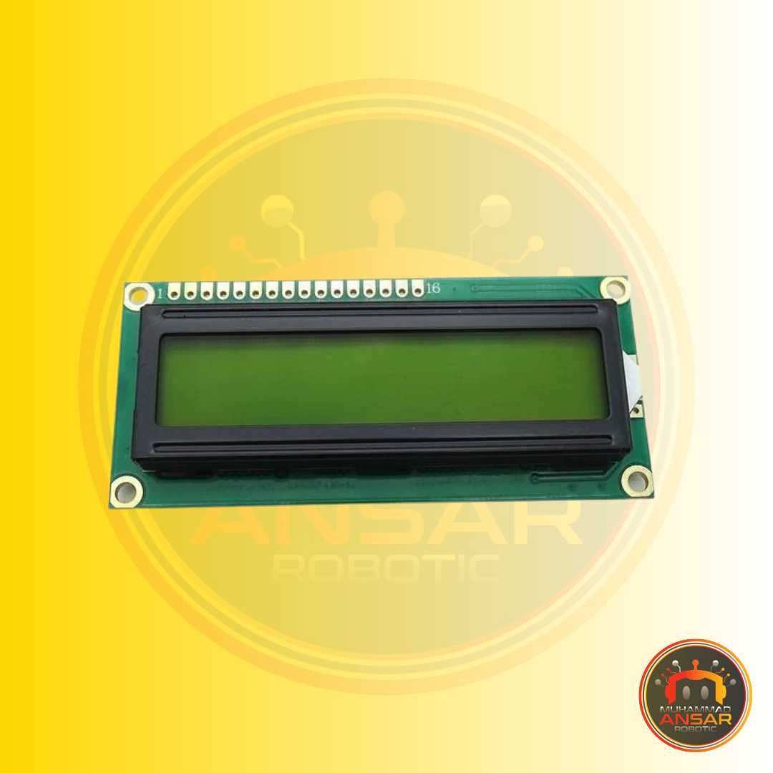
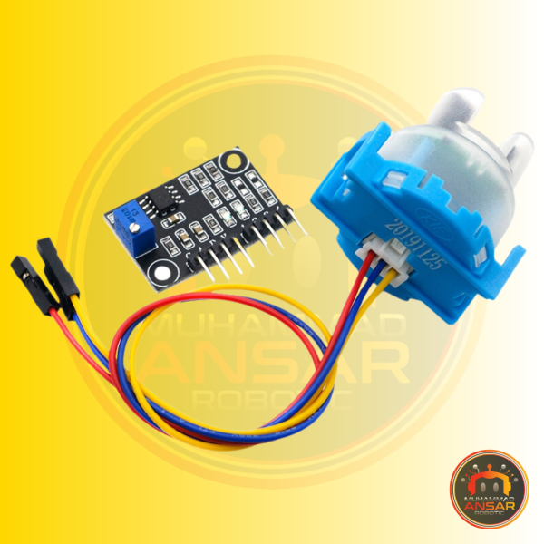
Bill of Material
Arduino UNO R3 DIP Board with USB Cable
Arduino UNO R3 DIP Board with USB Cable
Hard Jumper Wire 1 meter
16×2 LCD Display
Turbidity Sensor Module

Slide 11
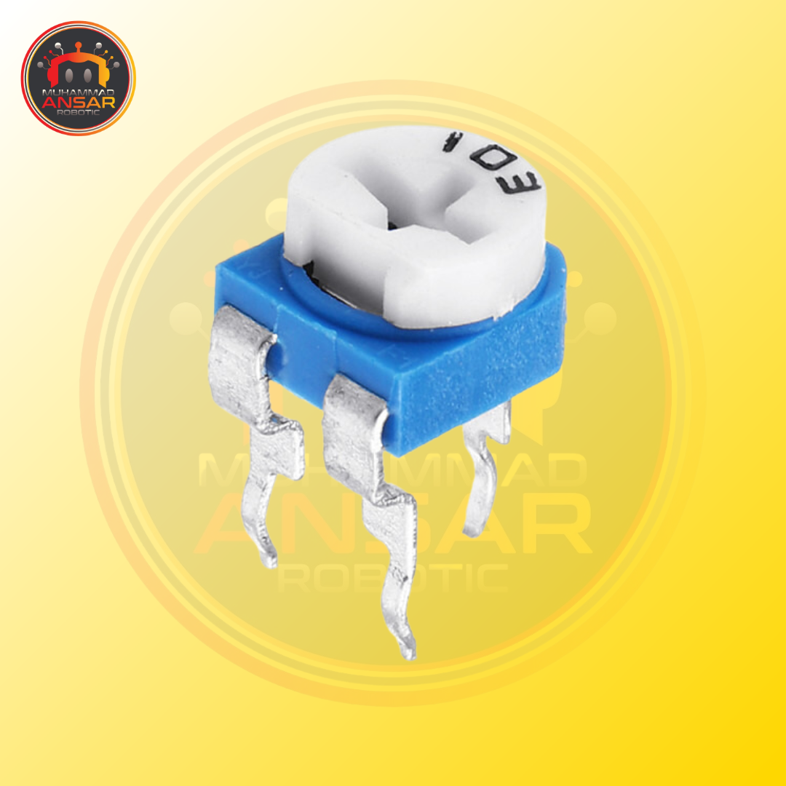
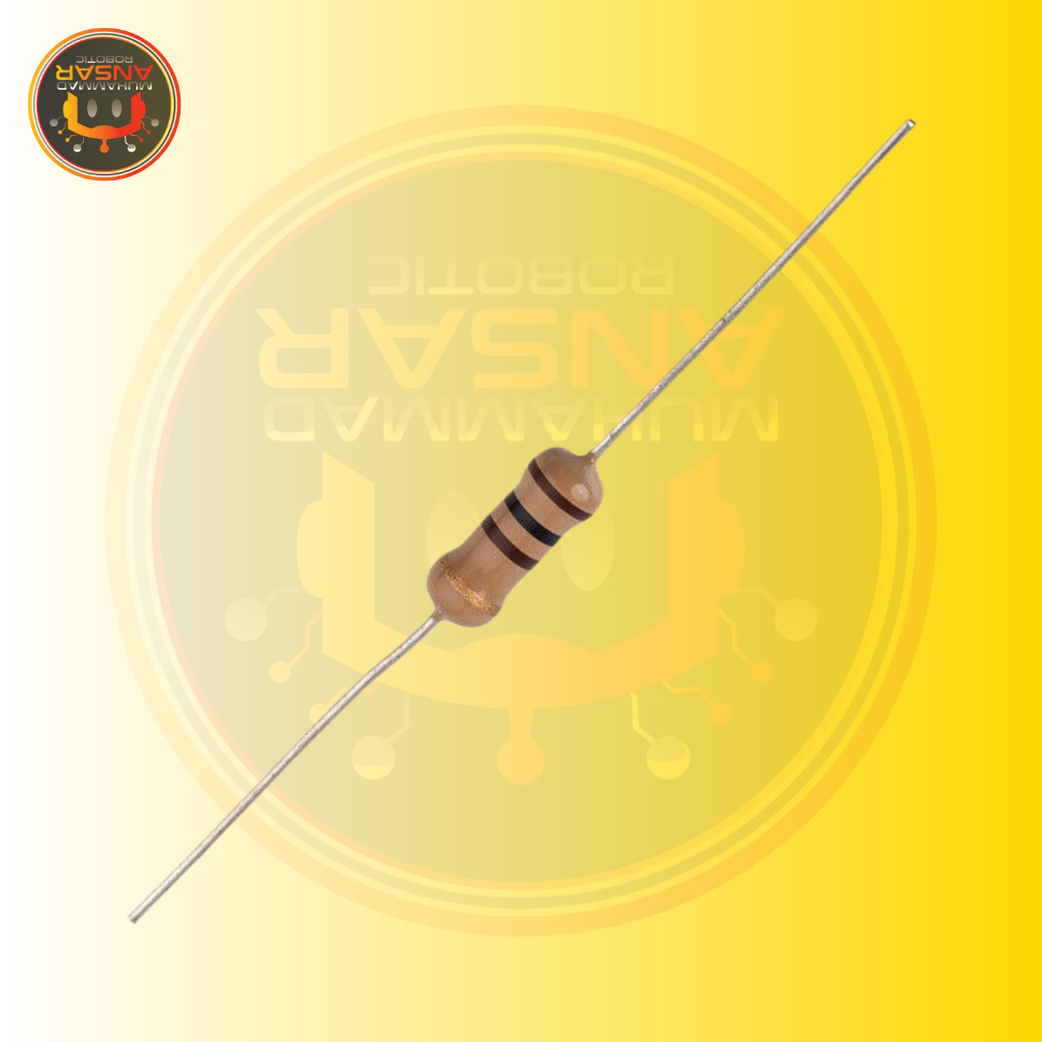
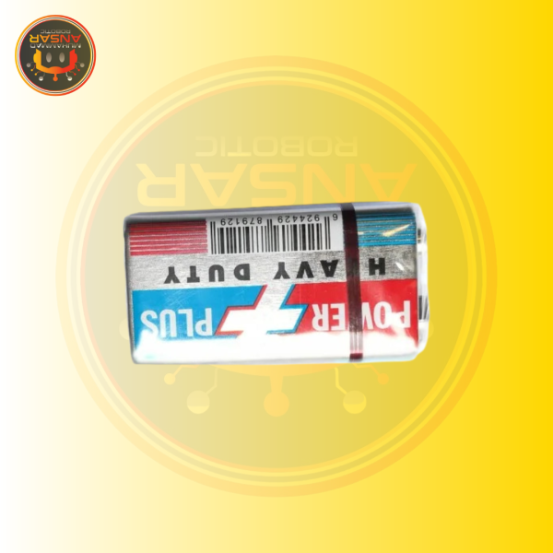
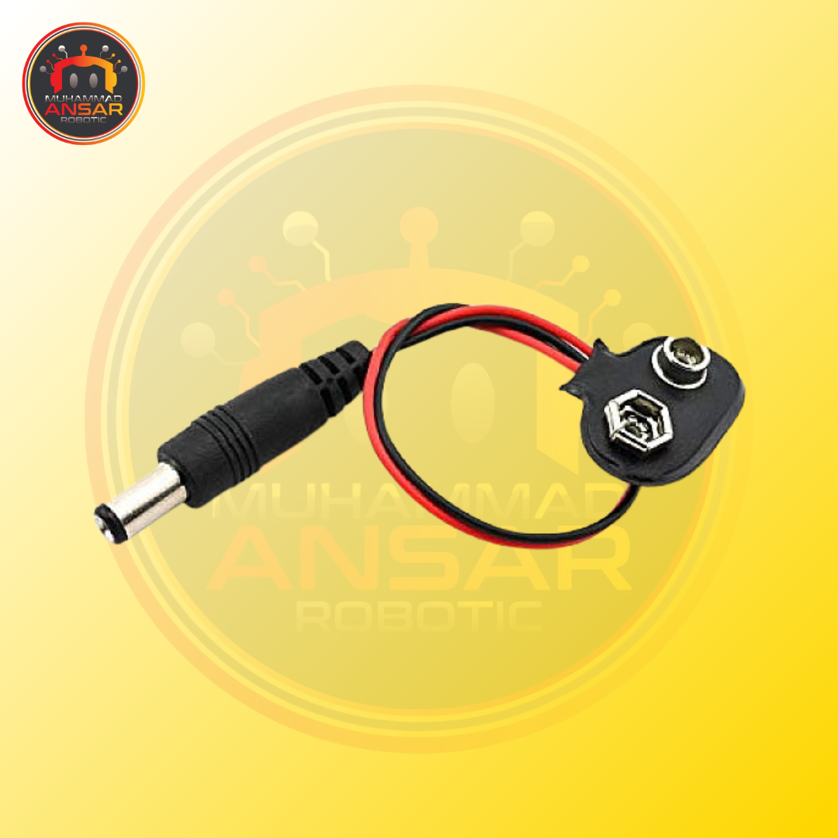
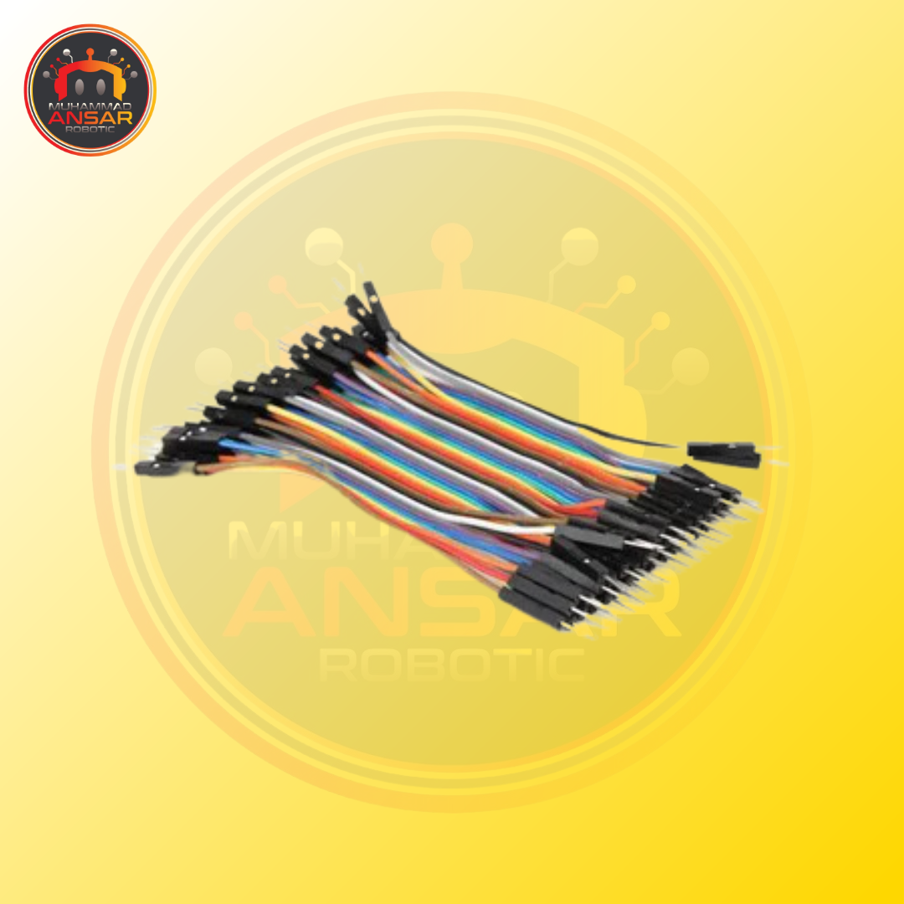
Bill of Material
10k Variable Resistor – 10k Potentiometer
5 PC 100R / 100 Ohm Resistance
9V Battery Module
9V Battery Snap Connector To DC Male Power Adapter Cable For Arduino
Male to Female Jumper Wires 10cm

Slide 12
Expected Outcomes
Upon completion, we anticipate the following outcomes:
Accurate measurement of turbidity levels in water samples.
Real-time monitoring of water quality parameters.
Enhanced decision-making capabilities for water management users.

Slide 13
Conclusion
Our study aims to develop a user-friendly system for measuring water quality.

Slide 14
Thank You

